Slide 1
The business cycle
In a Market Economy

Slide 2
Introduction
The business cycle is a period of Economic Fluctuation or Economic Change.
It is characterized by expansion and contraction, and is sometimes why people say we have a “Boom-Bust” system.
Each phase of the business cycle has an impact on the National Debt: the amount of money the Federal Government has borrowed.

Slide 3
Business cycle phases
Phase 1: Expansion
  A period characterized by Economic Growth, where there is a steady, long-term increase in Real GDP.
  In this phase, there are plenty of jobs, low unemployment, and business prospers.
Expansion
Expansion

Slide 4
Business cycle phases
Phase 2: Peak
  When GDP stops rising, the Economy has reached its Peak.
Peak
Peak

Slide 5
Business cycle phases
Phase 3: Contraction
  This period follows a peak, and is characterized by falling Real GDP.
  In this phase, people are losing jobs and business output is decreasing.
Contraction
Contraction

Slide 6
Business cycle phases
Phase 4: Trough
  In this phase, the economy is in the lowest point of contraction and Real GDP stops falling. It is followed by another period of economic expansion.
Trough
Trough

Slide 7
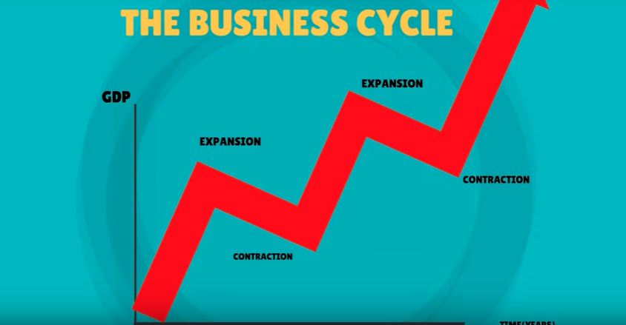

Slide 8
Features of Economic Contraction
Recession: Real GDP falls for 2 consecutive quarters (aka 6 straight months)
  Unemployment rates around 6-10 percent.
Depression: A long-term Recession (over 18 months or so)
  There is no explicit definition for a depression, but it is characterized by high Unemployment and low economic output.
Stagflation: A decline in Real GDP (stagnant) and an increase in price level (inflation).

Slide 9
Predicting the business cycle
Factors that impact the Business Cycle:
  Business Investment
  Interest Rates / Credit
  Consumer Expectations
  External Shocks
Each of these factors eventually lead to the “Boom-Bust” cycle we experience through time.

Slide 10
Business cycle predictions
Business Investment:
  Spending on business creates increased output and jobs. This increases GDP and helps expansion.
  Cutting back on business spending does the opposite and decreases GDP. If enough firms cut spending, a recession can result.
Government changes to Interest Rates / Credit:
The rate of interest and credit impacts both Consumers and Producers.
  When interest rates are low, people and businesses are more likely to borrow money. Leading to increased spending and expansion.
  When interest rates are high, people and businesses are less likely to borrow money. Leading to decreased spending and contraction.

Slide 11

Business cycle predictions
Consumer Expectations:
  If consumers expect the economy to keep growing they will increase spending and increase GDP (Remember C+I+G+Xn)
  If consumers expect the economy to contract, they will decrease spending and GDP will decrease.
External Shocks: The most unpredictable
  An event that causes a dramatic change in an economy’s aggregate supply.
  Examples: A massive oil spill, the outbreak of war, discovery of new resources.

Slide 12
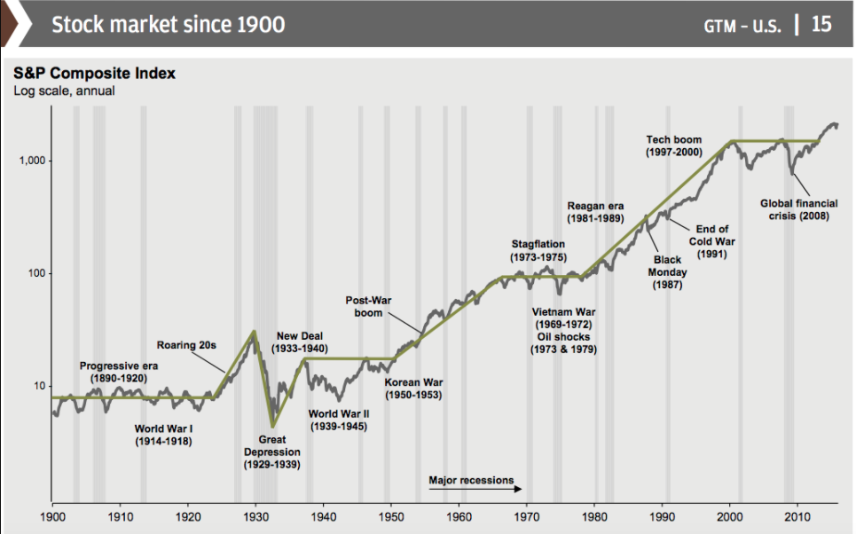

Slide 13
Business cycles throughout U.S. History
Following the Stock Market crash in 1929, GDP fell by about 25% and Unemployment rose sharply. 1 out of every 4 workers was jobless.
  It was during the Great Depression that the United States’ perception of government influence on the economy changed.
In the mid-1990’s the invention of the internet and the increase in tech industry created the dot.com boom.
  This period was characterized by huge expansion in the U.S. economy as a new sector was introduced.

